Slide 1
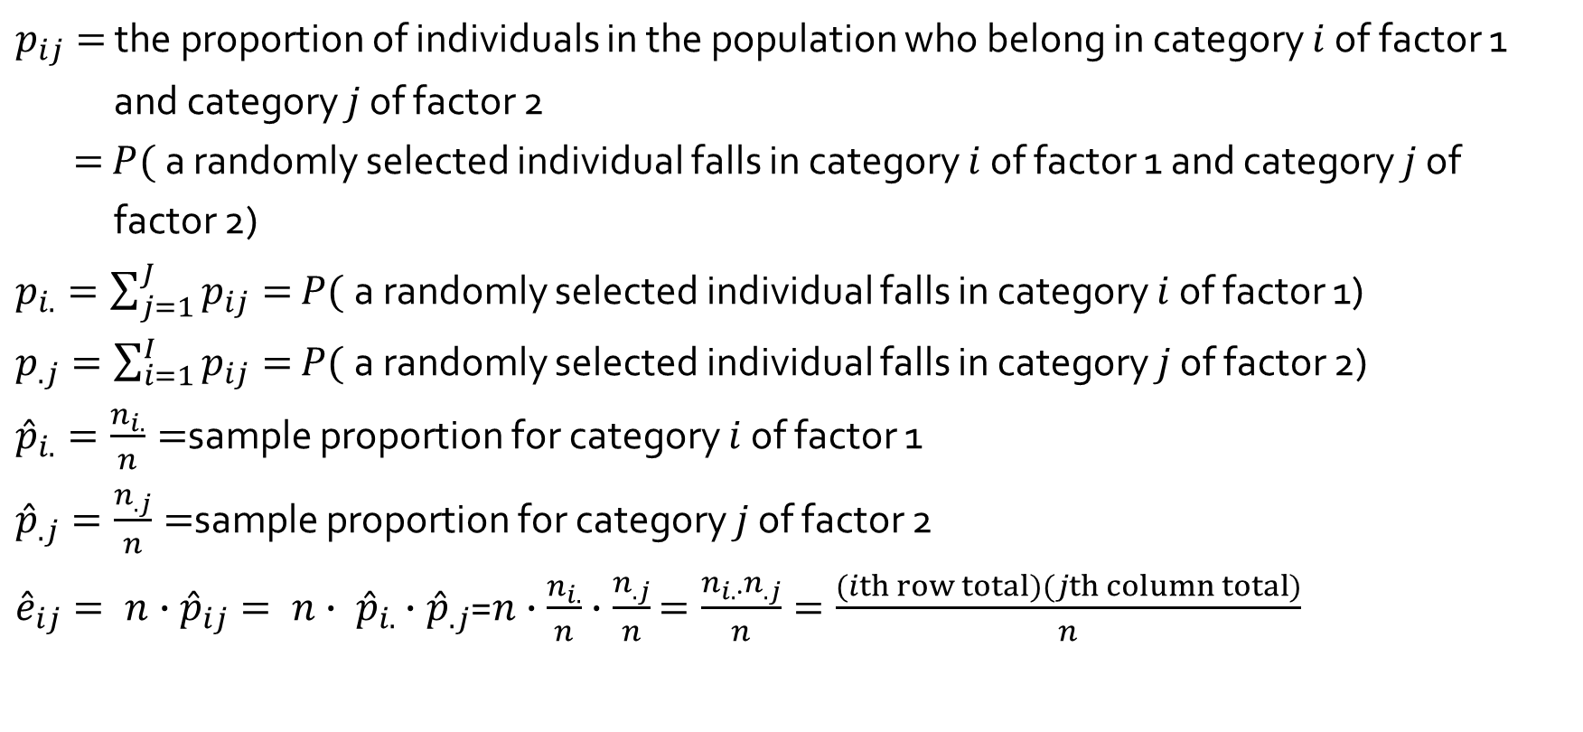
Testing for Independence
$p_{ij}=$ the proportion of individuals in the population who belong in category $i$ of factor 1
and category $j$ of factor 2
$=$ $P($a randomly selected individual falls in category $i$ of factor 1 and category $j$ of
factor 2)
$p_{i.}=\sum_{j=1}^{J}{p_{ij}}=$ $P($a randomly selected individual falls in category $i$ of factor 1)
$p_{.j}=\sum_{i=1}^{I}{p_{ij}}=$ $P($a randomly selected individual falls in category $j$ of factor 2)
${\hat{p}}_{i.}=\frac{n_{i.}}{n}=$sample proportion for category $i$ of factor 1
${\hat{p}}_{.j}=\frac{n_{.j}}{n}=$sample proportion for category $j$ of factor 2
${\hat{e}}_{ij}= n∙{\hat{p}}_{ij}= n∙ {\hat{p}}_{i.}$ $∙{\hat{p}}_{.j}$=$n∙\frac{n_{i.}}{n}∙\frac{n_{.j}}{n}$ $=\frac{n_{i.∙}n_{.j}}{n}=\frac{(ith row total)(jth column total)}{n}$

Slide 2

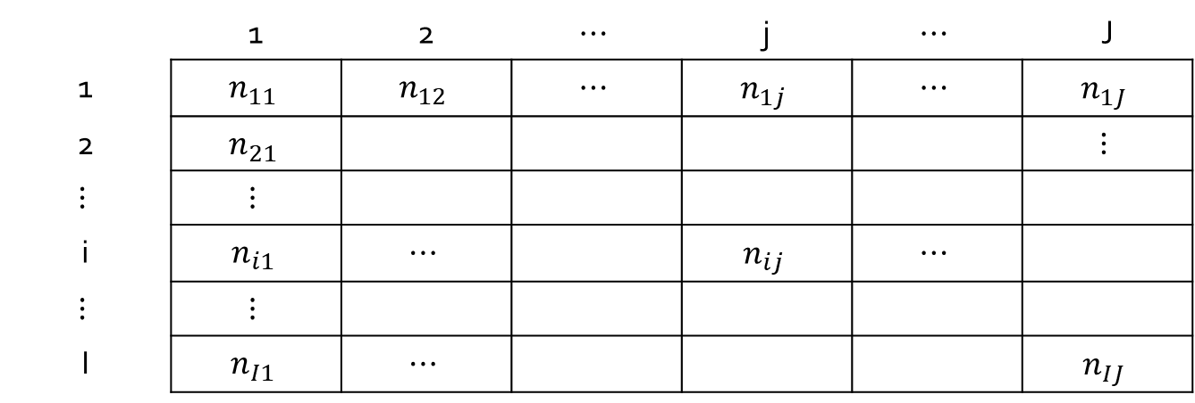

14.3 Two-Way Contingency Tables
We consider problems in which the data table have I rows and J columns.
Table 14.9 A Two-Way Contingency Tables
 | 1 | 2 | $$⋯$$ | j | $$⋯$$ | J
1 | $$n_{11}$$ | $$n_{12}$$ | $$⋯$$ | $$n_{1j}$$ | $$⋯$$ | $$n_{1J}$$
2 | $$n_{21}$$ |  |  |  |  | $$⋮$$
$$⋮$$ | $$⋮$$
i | $$n_{i1}$$ | $$⋯$$ |  | $$n_{ij}$$ | $$⋯$$
$$⋮$$ | $$⋮$$
I | $$n_{I1}$$ | $$⋯$$ |  |  |  | $$n_{IJ}$$
$$n_{i}.$$
$$n_{.j}$$

Slide 3
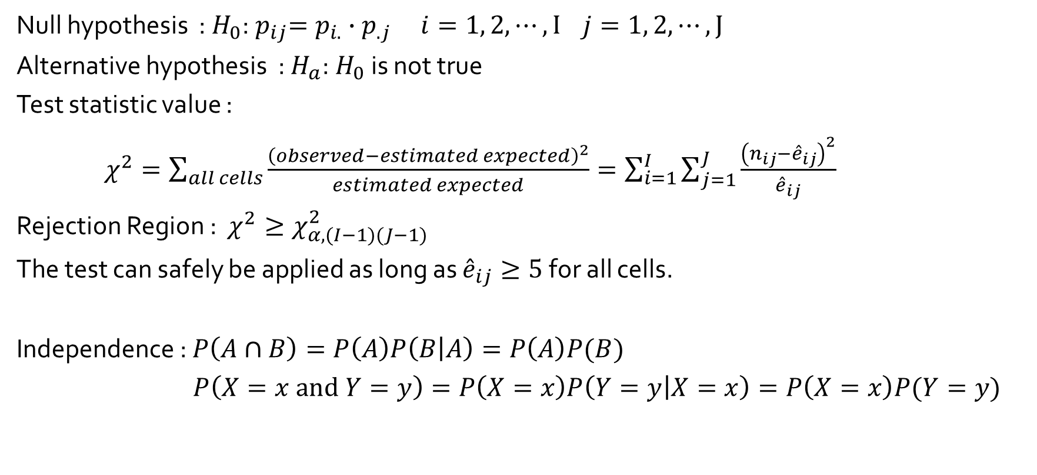
Testing for Independence
Null hypothesis : $H_{0}$:${ p}_{ij}=p_{i.}∙p_{.j} i=1, 2,⋯, I$ $j=1, 2,⋯, J$
Alternative hypothesis : $H_{a}$:$H_{0}$ is not true
Test statistic value :
$χ^{2}=\sum_{all cells}{\frac{{\left(observed−estimated expected\right)}^{2}}{estimated expected}}=\sum_{i=1}^{I}{\sum_{j=1}^{J}{\frac{{\left(n_{ij}−{\hat{e}}_{ij}\right)}^{2}}{{\hat{e}}_{ij}}}}$
Rejection Region : $χ^{2}≥χ_{α,(I−1)(J−1)}^{2}$
The test can safely be applied as long as ${\hat{e}}_{ij}≥5$for all cells.
Independence : $P\left(A∩B\right)=P\left(A\right)P\left(B | A\right)=P\left(A\right)P(B)$
$P\left(X=x and Y=y\right)=P\left(X=x\right)P\left(Y=y | X=x\right)=P\left(X=x\right)P(Y=y)$

Slide 4
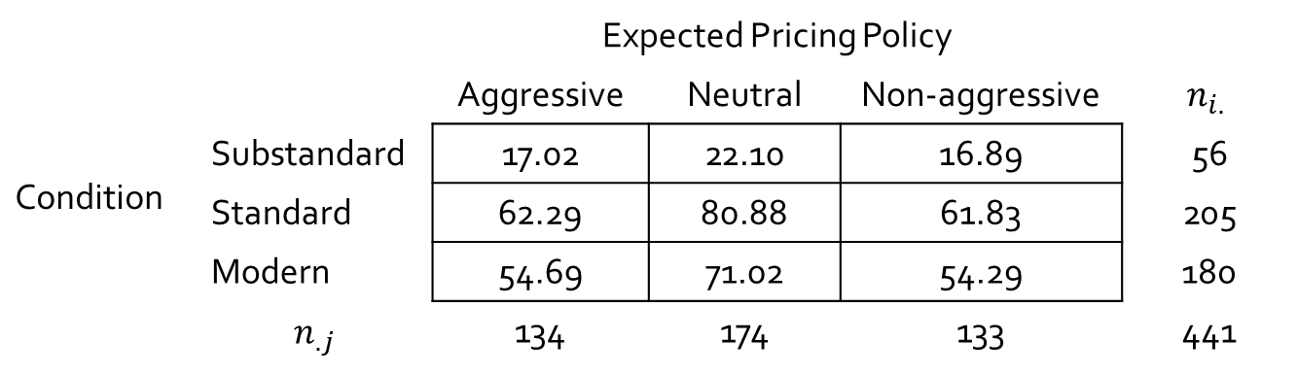
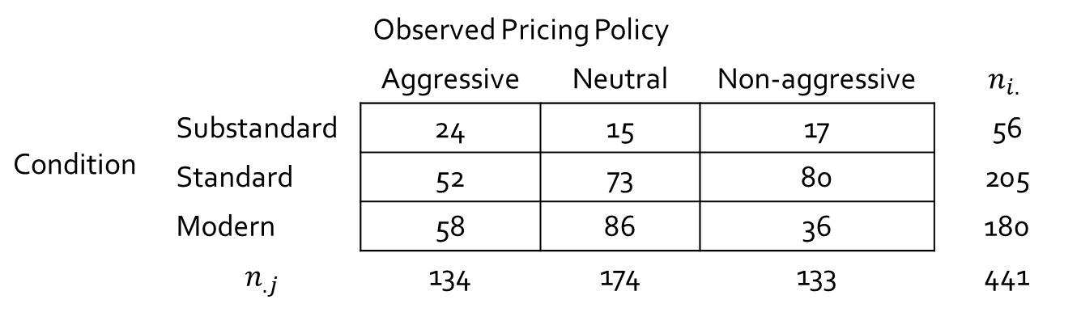
Testing for Independence
Example 14.14 : A study on the relationship between facility conditions at gasoline stations and aggressiveness in the pricing of gasoline.
 |  | Observed Pricing Policy
 |  | Aggressive | Neutral | Non-aggressive | $$n_{i.}$$
Condition | Substandard | 24 | 15 | 17 | 56
 | Standard | 52 | 73 | 80 | 205
 | Modern | 58 | 86 | 36 | 180
 | $$n_{.j}$$ | 134 | 174 | 133 | 441
 |  | Expected Pricing Policy
 |  | Aggressive | Neutral | Non-aggressive | $$n_{i.}$$
Condition | Substandard | 17.02 | 22.10 | 16.89 | 56
 | Standard | 62.29 | 80.88 | 61.83 | 205
 | Modern | 54.69 | 71.02 | 54.29 | 180
 | $$n_{.j}$$ | 134 | 174 | 133 | 441

Slide 5
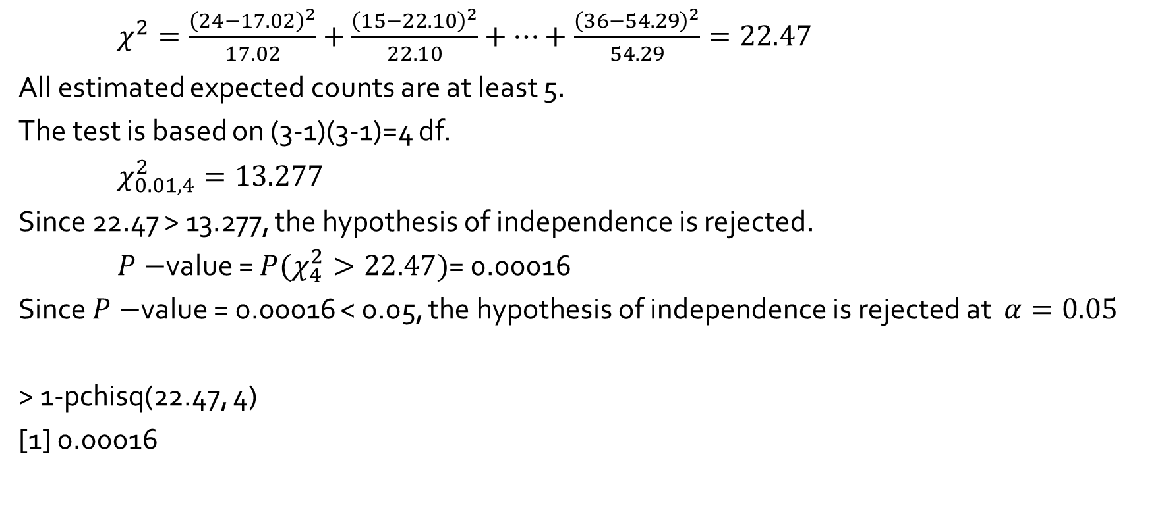
Testing for Independence
$χ^{2}=\frac{{\left(24−17.02\right)}^{2}}{17.02}+$ $\frac{{\left(15−22.10\right)}^{2}}{22.10}+⋯+\frac{{\left(36−54.29\right)}^{2}}{54.29}=22.47$
All estimated expected counts are at least 5.
The test is based on (3-1)(3-1)=4 df.
$χ_{0.01,4}^{2}=13.277$
Since 22.47 > 13.277, the hypothesis of independence is rejected.
$P−$value = $P(χ_{4}^{2}>22.47)$= 0.00016
Since $P−$value = 0.00016 < 0.05, the hypothesis of independence is rejected at $α=0.05$
> 1-pchisq(22.47, 4)
[1] 0.00016

